Slide 1

PROJECT B
PROJECT TITLE: BLOCKCHAIN-BASED VOTING SYSTEM FOR KENYA AIRWAYS
PRESENTER: MICHAEL ORINA
REGNO: SCII/00825/2019
DATE: 21/8/2023

Slide 2
INTRODUCTION
Introduction
The process of voting in Kenya Airways is quite tedious for shareholders because of the extensive information they have to go through, cost and security issues.
Traditional voting methods is vulnerable to fraud and errors.
With blockchain technology, a blockchain-based voting system offers a more secure and cost-effective solution.
By implementing a blockchain-based voting system, Kenya Airways has the potential to provide a secure and transparent method for conducting voting.

Slide 3
BACKGROUND STUDY
Background Study
Kenya Airways is publicly traded in the NSE and owned by private owners which means it holds AGM every year and carry out voting to determine various aspects of governance.
This process is always hectic to the shareholders.
The transparency, security and auditability of the process is almost an impossible idea due to various factors is place.
By implementing a blockchain-based voting system, we would be increasing the trust of the voting process

Slide 4
PROBLEM STATEMENT
To develop a web-based application implemented on a blockchain platform that allows Kenya Airways shareholders to vote on proposed resolutions.

Slide 5
OBJECTIVES
Overall Goal - To develop a web-based application implemented on a blockchain platform that allows Kenya Airways shareholders to vote on proposed resolutions.
Specific Objectives
To design an intuitive user-friendly web-based interface.
To develop interactive voting elements such as buttons, checkboxes, and progress indicators.
To implement smart contracts that automate vote recording, tallying, and result generation.
To ensure mobile responsiveness by designing the interface to be responsive and adaptable across various devices.
To design shareholder profiles with relevant information and historical voting records.

Slide 6
SCOPE
Review the information and proposed resolution to be voted on.
Cast votes.
The votes would be recorded on the blockchain platform in a tamper-proof manner, ensuring the integrity of the voting process.
Automated vote counting process.
Real-Time display of results.
The system would also include a way for shareholders to download and print the voting results for record keeping.

Slide 7
JUSTIFICATION
The system will provide the following benefits to the Kenya Airways Shareholders:
Improved Corporate Governance by reducing the potential for fraud and conflicts of interest which enhances the trust and confidence.
Enhanced Security by making it impossible to manipulate the voting results.
Improved Efficiency by eliminating the need for intermediaries, paper-based documentation, and manual vote counting, reducing the administrative burden on the organization.
Alignment with Technology Trends.

Slide 8
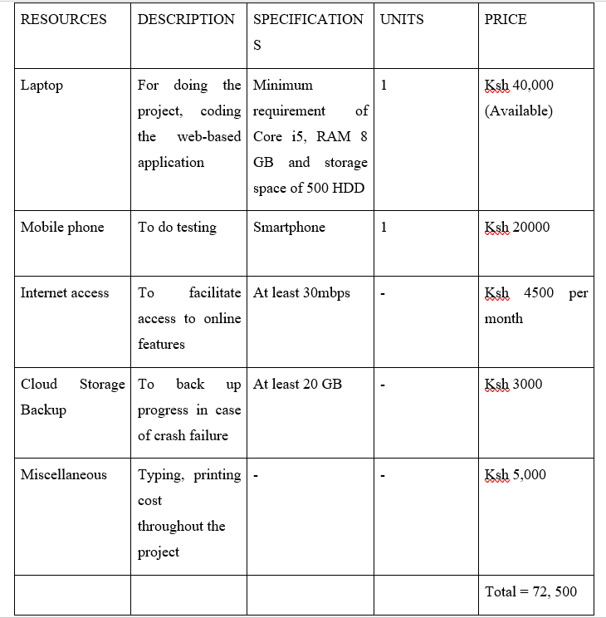
COST/REQUIREMENTS

Slide 9
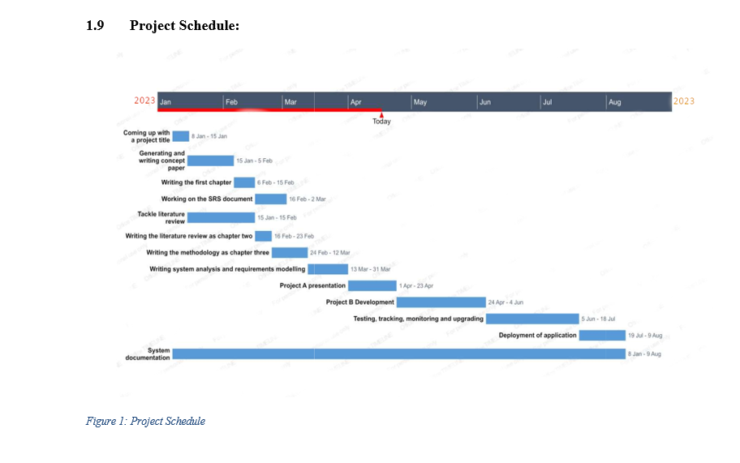
PROJECT SCHEDULE

Slide 10
LITERATURE REVIEW
Reviewed similar Systems
Unstructured Supplementary Service Data (USSD) Code Voting System.
Shareholders wishing to participate in the meeting, register for the AGM by dialing the USSD code for all networks and following the various prompts regarding the registration process.
The AGM is streamed live via a link which is provided to all registered shareholders. They can then vote (When prompted by the chairman) via the USSD prompts.
C & R System
C&R is a long-term client relationships system that specializes in providing end-to-end solutions for the efficient management of AGMs for Kenya Airways and other companies.

Slide 11
LITERATURE REVIEW cont.
The system has a secure and user-friendly online voting platform which allows shareholders to cast their votes remotely
Computershare Virtual Meeting System.
Computershare's VMS provides Kenya Airways with a comprehensive solution for conducting Annual General Meetings (AGMs) and other important company meetings remotely.
The advanced voting capabilities allows shareholders to cast their votes on resolutions and proposals before or during the meeting.

Slide 12
METHODOLOGY/DEVELOPMENT TOOLS
Methodology
For this project, Agile Methodology has been used. It is an iterative and flexible approach that emphasizes continuous improvements.
Development Tools
Flow Charts
Use Case Diagrams
Data Flow Diagrams

Slide 13
SYSTEM ANALYSIS AND REQUIREMENTS MODELING
Introduction
With a focus on optimizing the voting system, the project aims to enhance shareholder engagement through streamlined and secure processes. By dismantling traditional barriers and embracing decentralization, the envisioned system embodies transparency, efficiency, and operational viability.
Objectives of system Analysis
To understand how things are currently being done and what improvements are needed.
Problem Definition
The current manual shareholder voting process at Kenya Airways lacks transparency, is time-consuming, and prone to errors.

Slide 14
SYSTEM ANALYSIS AND REQUIREMENTS MODELING cont.’
Feasibility Study
It evaluates the practicality and viability of implementing the blockchain-based voting system, considering technical, operational, economic, and schedule aspects.
System analysis tools
Use Case Diagrams
Flow Chart
Entity Relationship Diagrams

Slide 15
SYSTEM DESIGN
System design is the step where we turn ideas into a detailed plan. In our case, it's about creating a clear structure for the blockchain-based voting system for Kenya Airways shareholders.
Design Objectives
User-Centric Interface by designing an intuitive and user-friendly interface that allows shareholders to easily navigate the system and cast their votes.
Immutable Data Integrity by developing a system architecture that integrates blockchain technology.
Responsive Multi-Device Access that adapts seamlessly to various devices

Slide 16
SYSTEM DESIGN cont..
Program Design Tools
Flow charts
Use Case
Data Flow Diagram

Slide 17
IMPLEMENTATION
It describes how the different parts of the system are interacting with each other to give us a feasible software solution.
Coding tools
VsCodium
NextJS, ReactJS, Node, Firebase
Change Over Techniques
Pilot change-over technique as the application is rolled out and deployed. This technique involves deploying the application to a sample group of users while increasing to a larger number with time.

Slide 18
CONCLUSIONS
To sum up, the blockchain-based voting system for Kenya Airways shareholders is a smart blend of technology and real-world needs. The system's design and testing show that it can make voting easier and more honest. By using this system, shareholders can be more involved in decision-making and trust the process. With thoughtful planning and user-friendly guidance, this system promises to change how we all work together for the better.

Slide 19
RECOMMENDATIONS
ethbvoting is still a long way from being commercially viable as a product. I recommend the following for future versions:
Multi-Language Support: Introduce support for multiple languages to cater to a diverse group of shareholders.
Mobile App Integration: Develop a mobile app version for convenient voting on smartphones and tablets.

Slide 20
REFERENCES
Kshetri, N. (2017). Can blockchain strengthen the internet of things? IT Professional, 19(4), 68-72.
Johnson, M. P. (2018). Design and implementation of a secure blockchain-based electronic voting system. In Proceedings of the International Conference on Computational Science and Computational Intelligence (pp. 18-23).
Chen, C. S., & Liao, Y. H. (2018). Development of a blockchain-based e-voting system: Design and implementation. In Proceedings of the IEEE/RSJ International Conference on Intelligent Robots and Systems (IROS) (pp. 6224-6230).
Sasaki, H., Mori, K., & Matsuo, K. (2018). Blockchain-based secure voting system. In Proceedings of the International Conference on Smart Grid and Blockchain (pp. 175-180).
Pop, C., & Toma, C. (2019). Using blockchain technology for secure electronic voting. In Proceedings of the International Conference on Security for Information Technology and Communications (pp. 79-91).
Mylrea, M. E. (2019). Blockchain voting systems: Can democracy be hacked? IEEE Security & Privacy, 17(5), 85-89.
Smith, J. A. (2020). Blockchain technology in corporate governance: Enhancing shareholder participation and transparency. Corporate Governance: An International Review, 28(4), 203-218.
Özdemir, S., & Sari, A. (2020). A survey on blockchain-based voting systems. Computer Networks, 175, 107285.

